Slide 1
Module 5: Lesson 6 Transformations – Spark SQL

Slide 2
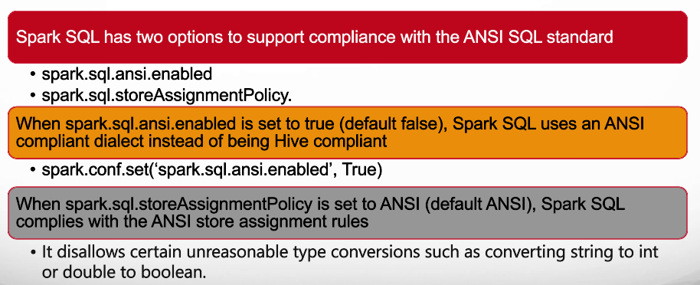
Configuring the Spark SQL API

Slide 3
Data Processing Using SQL Queries
The Spark SQL API enables users to interact with data using SQL queries, providing a familiar and powerful interface for those experienced with relational databases
Users can execute SQL queries directly on Spark DataFrames registered with the SparkSession
Spark SQL conforms to the ANSI SQL standard
Additionally, Spark SQL also provides support for HiveQL, a SQL-like language specific to Apache Hive (another Hadoop SQL query engine)

Slide 4
Using Spark SQL
Spark maintains isolation between its own procedural language variable namespace and the SQL table (view) namespace
When we assign a DataFrame to a variable Spark SQL does not have visibility of that variable or the DataFrame it references
To query a DataFrame using Spark SQL you must explicitly make a DataFrame visible to SQL operations as a view
“view” means that no additional storage is allocated to create a separate SQL table that duplicates the DataFrame contents

Slide 5
Creating a View
To make a DataFrame visible to Spark SQL use the following
DataFrame.createOrReplaceTempView(name)
The parameter sqlQuery holds a SQL query as a string
targetDF = srcDF.filter(srcDF[‘mpg’] < 30)
targetDF.createOrReplaceTempView(‘someView’)
Note, although you can give the view the same name as the variable referencing the DataFrame you are not forced to

Slide 6
Querying a View
Now that we have made a view visible for access through Spark SQL we can apply SQL queries to it using the following
SparkSession.sql(sqlQuery) → DataFrame
This method takes a single string parameter which is the name by which Spark SQL will refer to the DataFrame
The function returns a DataFrame representing the result of the given SQL query
Note, because sql() returns a DataFrame we can mix DataFrame API and SQL API functions together, as appropriate, in our code

Slide 7
Spark SQL Examples
srcDF.createOrReplaceTempView(“autompg”)
targetDF1 = spark.sql("select carname, mpg, horsepower from autompg where horsepower > 100 and mpg > 25”)
targetDF2 = spark.sql("select carname, mpg, horsepower from autompg where horsepower between 20 and 30”)
targetDF3 = spark.sql( "select modelyear, avg(mpg) from autompg group by modelyear" )

Slide 8
DataFrames Versus Spark SQL
# Sample data data = [ (1, "John", "Doe", 50000), (2, "Jane", "Smith", 60000), (3, "Mike", "Johnson", 55000), (4, "Emily", "Williams", 70000) ] # Create a DataFrame from the sample data columns = ["employee_id", "first_name", "last_name", "salary"] df = spark.createDataFrame(data, columns)
# Perform DataFrame API operations result = df.select("first_name", "last_name", "salary") \ .filter(col("salary") > 55000) \ .orderBy(col("salary").desc())
# Show the result result.show()
# Sample data data = [ (1, "John", "Doe", 50000), (2, "Jane", "Smith", 60000), (3, "Mike", "Johnson", 55000), (4, "Emily", "Williams", 70000) ] # Create a DataFrame from the sample data columns = ["employee_id", "first_name", "last_name", "salary"] df = spark.createDataFrame(data, columns) # Create a temporary view to use Spark SQL df.createOrReplaceTempView("employees") # Perform Spark SQL operations result = spark.sql(""" SELECT first_name, last_name, salary FROM employees WHERE salary > 55000 ORDER BY salary DESC """) # Show the result result.show()

Slide 9
Spark SQL Benefits
Declarative Nature
Spark SQL represents a declarative query language that enables users to specify what they want rather than how to achieve it
Familiar Syntax
For developers with a strong background in SQL, Spark SQL offers a seamless transition into the Spark world and reduces the learning curve
Readability and Simplicity
Complex transformations that might require intricate DataFrame operations can often be expressed succinctly through SQL queries
Abundant Resources
Extensive documentation, tutorials, and community support are readily available for SQL
Portable and Standardized
SQL queries are generally transferable and reusable with minimal changes from relational database systems to use the Spark SQL API

Slide 10
Spark SQL Benefits
Hybrid Workflows
Spark SQL allows blending the declarative nature of SQL views with the flexibility of DataFrame transformations enabling complex data pipelines
Performance
There is no performance difference between writing SQL queries or writing DataFrame API code. They both “compile” to the same underlying execution plan
Readability and Simplicity
Writing basic queries and joins is straightforward and concise, especially for less complex tasks
Scalability
Built upon Spark's distributed engine, Spark SQL seamlessly scales to analyze massive datasets that traditional SQL-based systems might struggle with
Optimized Storage Formats
Spark SQL optimizes data storage through the support of columnar storage formats such as Parquet and ORC. This feature enhances compression, reduces I/O operations, and accelerates query performance

Slide 11
Spark SQL Drawbacks
Native Library Integration
Spark SQL is isolated from external Java, Scala, R and Python libraries compared to the DataFrame API, which might be a limitation for advanced analytical tasks
Spark Extension Integration
Spark SQL is not well integrated with Spark extensions such as GraphX, GraphFrames, MLlib and Spark ML all of which use DataFrames or RDDs
Less Modular
Spark SQL statements combine many transformations together into an inseparable whole making it more difficult to compose pipelines from primitive components.
Debugging Challenges
Spark DataFrames, with their method chaining and programmatic approach, can provide more granular control over transformations, making it easier to debug

Slide 12
DataFrames Versus Spark SQL
Both the Spark DataFrame API and Spark SQL have benefits and drawbacks, making the choice contingent on specific use cases and developer preferences
For those who prioritize R, Scala, Java or Python language syntax, integration with language libraries, and fine-grained control over transformations, the DataFrame API is an excellent choice
It’s particularly beneficial for scenarios involving data preprocessing, feature engineering, machine learning or graph processing integration
For users comfortable with SQL, and those working with more complex transformations, Spark SQL proves advantageous
It’s particularly suited for cases where data analysis revolves around intricate querying and analytical tasks

